Slide 1
Q1: what is the highest amount the customer spent?
As we can see in the graph the customer “Eleanor” spent more than 200 and the lost customer is “June "spent about 150

Slide 2
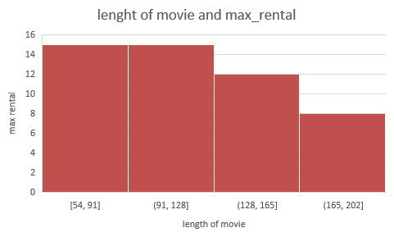
Q2: what is the MAX rate for all movies and there length
We can see the length of movies increasing while rental_rate decreasing

Slide 3
Q3: list of name of customers who payed more then Average ?
Her is top 20 customer whose pay greater than the average and we can see the customer Ricrdo pay the highest on

Slide 4
Q4: what is the name of movies that greater than the average length ?
Here the list of names of movies that length more than the average length Dying maker movie is more then 160

